Slide 1

Intersectionality and How It Relates to Writing and Teaching English Literature By Name:

Slide 2

Intersectionality
Conceived by Kimberle Crenshaw in 1989.
Holds that discrimination derives from diverse strains of oppression coincidentally.
Argues that discrimination is not a product of one single strain of oppression – such as sexism or racism.
Notes:
For instance, intersectionality would propose considering Black women’s experiences of prejudice holistically because they are overlapping and generative, instead of perceiving them singularly or distinctively as strictly sexism or racism. Literature has tried to employ intersectionality in analyses of identity, where it enables conceptualization of how expansive institutions of oppression, privilege, and power flow into social constructs like gender, race, sexuality and class.

Slide 3
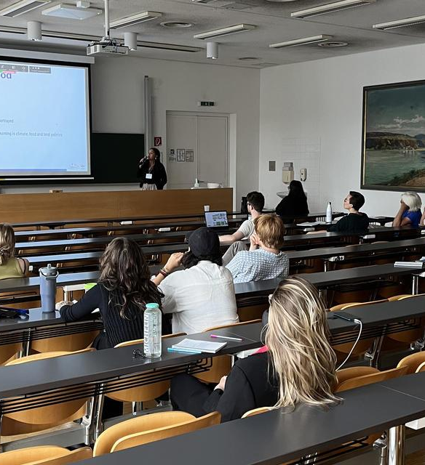
Intersectional Reading
As a literary analysis technique, intersectionality petitions students to ponder the impact of different variables on characters.
Students analyze how race, age, corporeality, gender, context, nationality, sexuality, role, class, or physical ability collide to mold literary characters.
Literary works with elaborately crafted social settings, such as Toni Morrison’s Sula, are especially suitable for intersectional literary reading.
Notes:
For courses that serialize readings, teachers can amend exercises and increase their degree of difficulty upon getting to later literary works. They can do this by requesting students to link three successive sections in the same text or by asking them to create thematic sets across literary works. For instance, they can juxtapose gender, setting and race and identify how they are analogous yet simultaneously divergent. This composite yet advanced form of bridges stretches beyond one day and can generate deeper insights for students about genre – types of fictional works – and period – avant-garde literary texts. Fictional works are especially effective in this exercise because teachers typically perceive modernist texts unconventionally while considering the uniqueness of fiction in its adoption of reading exercises and non-traditional structure.

Slide 4
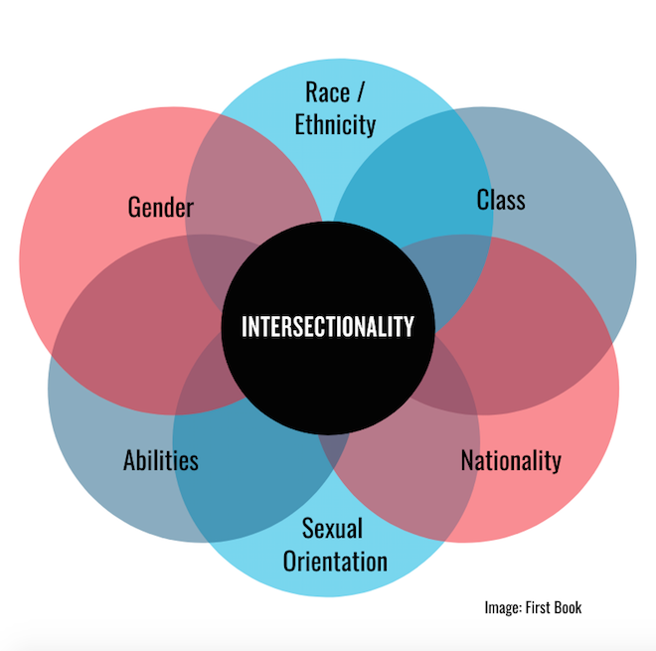
Intersectional Reading
Before class, teachers can select two personas from assigned texts that are a good match for juxtaposition across various factors.
They should decide on the range of material they want students to examine, such as specific passages with extensive character detail, specific sections or chapters, or whole texts.
After this, they can create two handouts, both with four rows and three columns.
Notes:
The orientation of the handouts should be landscape, and the area of the chart can be leveraged so that each box has adequate space. On the first handout, the first column should have Subjectivity Factor for a header while the remaining two headers should be the names of the personas. Below the first header, the three residual rows should be labeled with a specific subjectivity factor consequential to the chosen characters, such as class, race, and gender. Close Character Reading should be the title of this handout. The character names should be retained in the second handout but the header of the first column should be revised to Intersecting Factors. Below this header, the teacher should annotate the aspects of handout one as matching pairs, such as gender and race, race and class, or class and gender. The teacher should use Intersectional Reading as the title of handout two and duplicate it on another paper with a different color to make the forms easy to distinguish. The teacher can then ask students to juxtapose main personas from assigned texts.

Slide 5
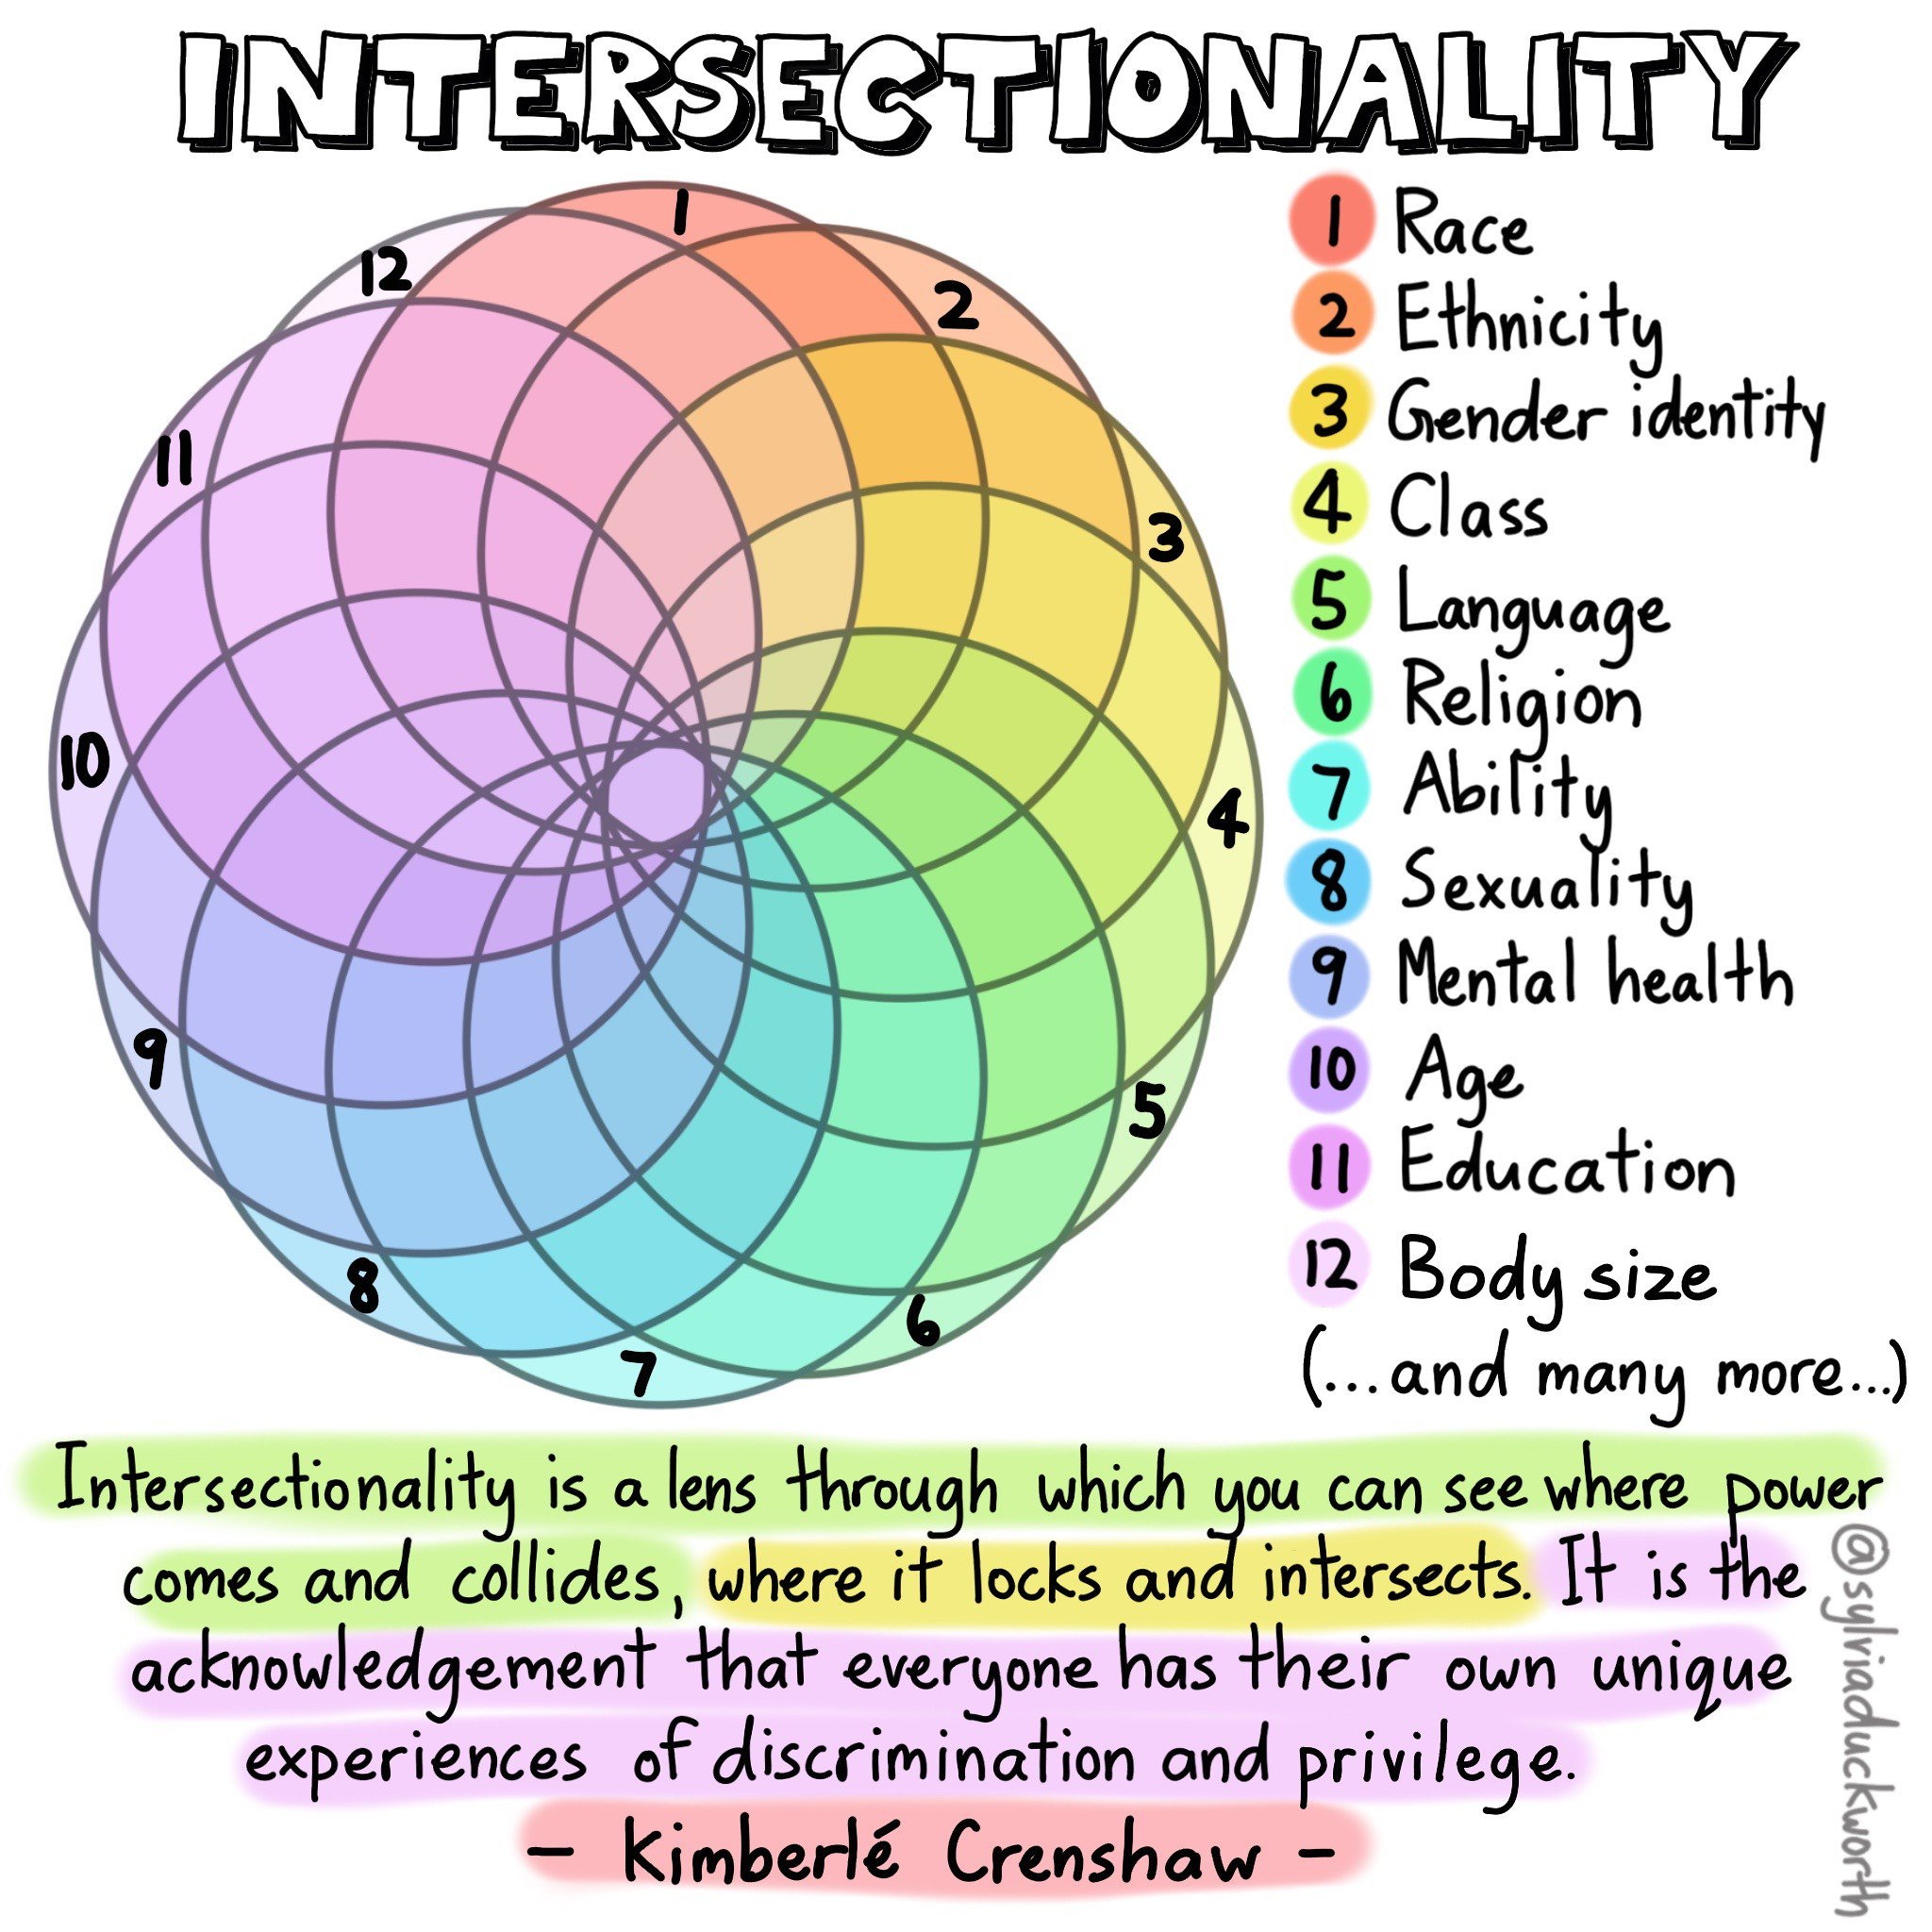
Intersectional Reading
In class, teachers should spend the opening few minutes going over the notion of intersectionality.
They should also review intersectionality’s capacity for a more elaborate deconstruction of the lived experience of a persona.
After this, they can partition the class into three or four groups and distribute duplicates of handout one.
Notes:
Each group should be asked to take 15-20 minutes filling the boxes on the chart while considering how the literary text addresses each subjectivity factor for each persona. Teachers can also give students examples before the start of the exercise to get them going. They should request students to be clear in recalling events and persona descriptions, including phrases, dialogue, direct allusions, scenes, plot arcs, words, and interactions. They should also ask students to quote page numbers when they can and reference the section of the literary text they are assigned. At this juncture, the groups should not just juxtapose the characters; rather, they should also consider each persona according to the listed factors. If students find overlapping categories, teachers should ask them to assign each detail in the most relevant box.

Slide 6
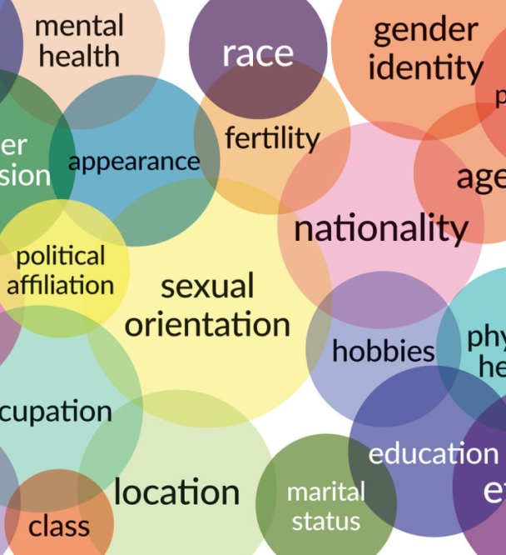
Intersectional Reading
When students have finished handout one, teachers should distribute duplicates of handout two.
Students should take 15-20 minutes filling the boxes in the fresh chart by examining how the subjectivity factors annotated overlap with one another.
Teachers should implore students to refer to handout one for specific information.
Students should also note the differences between these factors when juxtaposed across personas.
Notes:
Teachers should remind students to list page numbers for direct references. Like with handout one, some examples can help students break the ice and get started. During group sessions, teachers would also find it helpful to walk around the class, pry to hear what students are saying, and ask questions or provide cues for refining ideas. When students have completed handout two, teachers can reconstitute the class and take the residual class time analyzing all intersections.

Slide 7
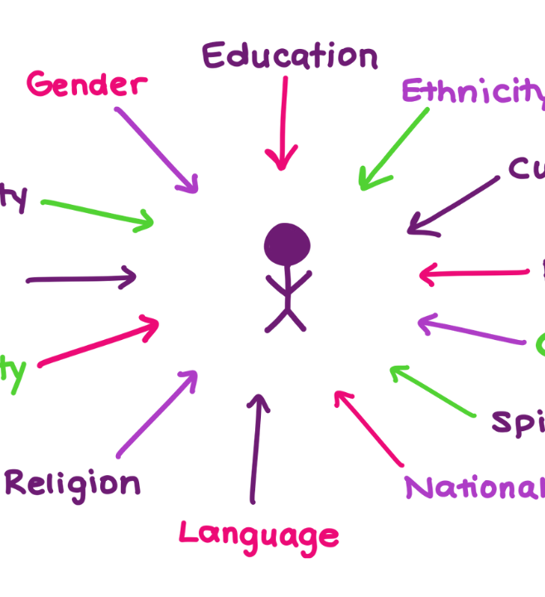
Intersectional Reading
Teachers should ask groups to discuss their discoveries on how a specific pair of intersecting dimensions enriches or limits the lived experience of each persona.
Teachers can also instruct students to define the lived experience of each persona.
Notes:
As part of this exercise, students should question how the abovementioned intersections exhibit convergences and divergences across personas? Teachers should instruct the groups to quote specific language employed by the authors and recognize the literal and figurative narrations in the text. When possible, group responses should be annotated on a common chart in front of the classroom, either on a projection monitor or the board. Considering the chaotic nature of intersectionality, the group discussions are likely to be disorderly. Students should be motivated to adopt this element and emphasize how it demonstrates the complexity of personas – and humans. It is also noteworthy that intersectional reading enables students to acknowledge and experiment with this disorder as they perform literary analyses in written assignments, whether formal or informal.

Slide 8

Intersectional Pedagogy
Intersectional pedagogy is premised on the following assumptions:
Using intersectionality to teach demands an emphasis on socio-political agency.
Identity is an intricate layering of different social settings.
Intersectionality is a tool for exposing oppression, privilege, and power.
Notes:
Syllabuses should be receptive to diverse perspectives and voices that showcase oppression and privilege. Intersectional pedagogy gives students fresh perspectives of perpetual trends of inequality consistent with and reflective of diversity and complexity. It also arms students with a sound model for affirming suppressed knowledge, analyzing the intricacy of identity, formulating interventions for empowerment, and exposing privilege and power.

Slide 9

Intersectional Pedagogy
Recognizing intersectional identities encourages students to open up unreservedly in the classroom and realize their importance no matter their backgrounds.
It can also prompt critical consideration of privilege in students from dominant identities.
Notes:
Teachers can incorporate students’ cultural encounters in all learning aspects to determine what identities are represented and discover opportunities to further diversify their classrooms. Students are more inclined to participate in literary activities when they identify their dispositions in literary texts, imagery, and assignments.

Slide 10

Intersectional Pedagogy
Literature teachers can periodically review their syllabuses to uphold diversity and inclusivity.
Such reviews prioritize literary texts that problematize and underscore prevailing social, cultural, and political themes.
Notes:
Teachers can focus on two primary patterns of investigation, namely re-evaluating previous studies from the catalogue through recent intersectional scholarship, and teaching innovative modern literary texts that strongly refer to the genre’s principles. Students are typically very interested in these ideas and embrace the chance to analyze topics that are important and relatable to them in their normal routines and to further contemplate issues of representing justice, intersectionality, and race. Literature teachers’ strategies allow students to thoroughly analyze controversial portrayals in earlier literary works. Students can reflect on depictions of gender, race, and class in course readings that illustrate the perpetuity of colonial power disparities. Students can also discuss sexist and homophobic representations and the implications of such depictions on masculine tropes. Teachers can use previous authoritative works as reference points for highlighting and critiquing inequality, privilege, homophobia, oppression, and discrimination. Teaching such orthodox works from an intersectional perspective allows instructors to build a strong critical base for students.

Slide 11

Intersectional Pedagogy
Literature teachers are inclined to show students how detect intersectionality with respect to its primary components.
These components are transformational disposition, critique of power, and reflexivity.
Notes:
In the context of intersectionality, reflexivity denotes conscious understanding of the impact of power and identity conflicts and asks students to consider their relationships, privileges, and identities. It also encourages critical contemplation to help detect beliefs, potential predispositions, and assumptions in relation to raising self-awareness. Teachers should foster reflexivity in students by practicing critical consciousness and reflection, analyzing socio-political, historical, and cultural in learners’ contexts, examining individual characters, and recognizing and probing biases and assumptions. These activities help students understand how their dispositions as social agents affect how they interact with literary characters. Specifically, it can lead to accountability for behavior, recognition of disadvantage, and detection of biases.

Slide 12

Intersectional Pedagogy
In academic settings, the perception of identity as situational and dynamic should be aligned with the application of intersectionality to establish the associations between purpose, context, and identity.
Students should also examine the function of identities by interrogating inequality and power, especially how they are promoted and sustained by specific structures.
Notes:
Teachers can use autobiographies, counter-storytelling, and critical reflections to raise understanding of intersectional contexts. Teachers should consider their intersectional traits in their critical deliberations in terms of the methods they employ. They can reflect on themes such as the centers of power and the biggest beneficiaries of such structures while examining how their identities intersect in terms of class, race, sexual identity, gender, ability and other important identities.

Slide 13
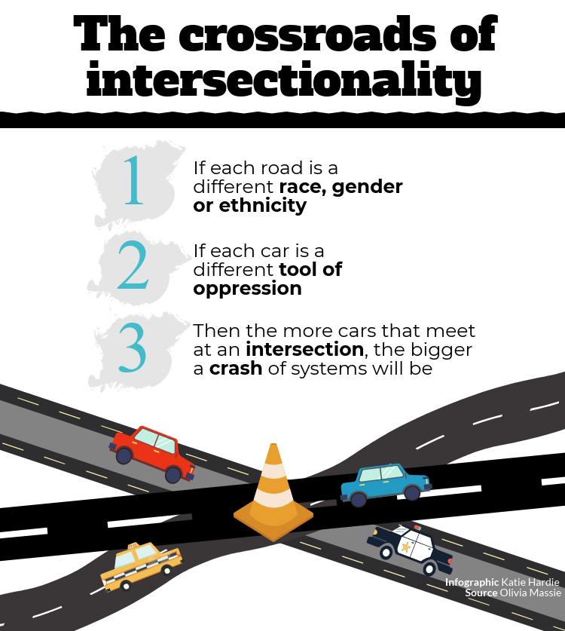
Intersectional Pedagogy
Students and teachers can use counter-storytelling, a critical reflective practice, to disrupt mainstream views and further social justice.
Through feedback systems and interviews with students, instructors can learn more about and interrogate their perception of their preferred intersection, such as race or sex.
Notes:
Sharing insights gleaned from storytelling is a valuable learning resource. An centres intersectional, anti-racist pedagogy effectively combines, nurtures, and equates racial contexts that support and engender solidarity and equity among students of all racial extractions. Teachers have the freedom to choose literary works that confront established tropes and inequality according to students’ purposes or proficiency levels. Teachers can incorporate intersectionality by setting up creative classrooms. For example, they can request students to adopt hypothetical identities and tell stories about their experiences with intersectionality and share it as a class exercise. Teachers can use this intentional, communicative, and humanistic approach to encourage students to confront issues associated with intersectionality, such as identity.

Slide 14
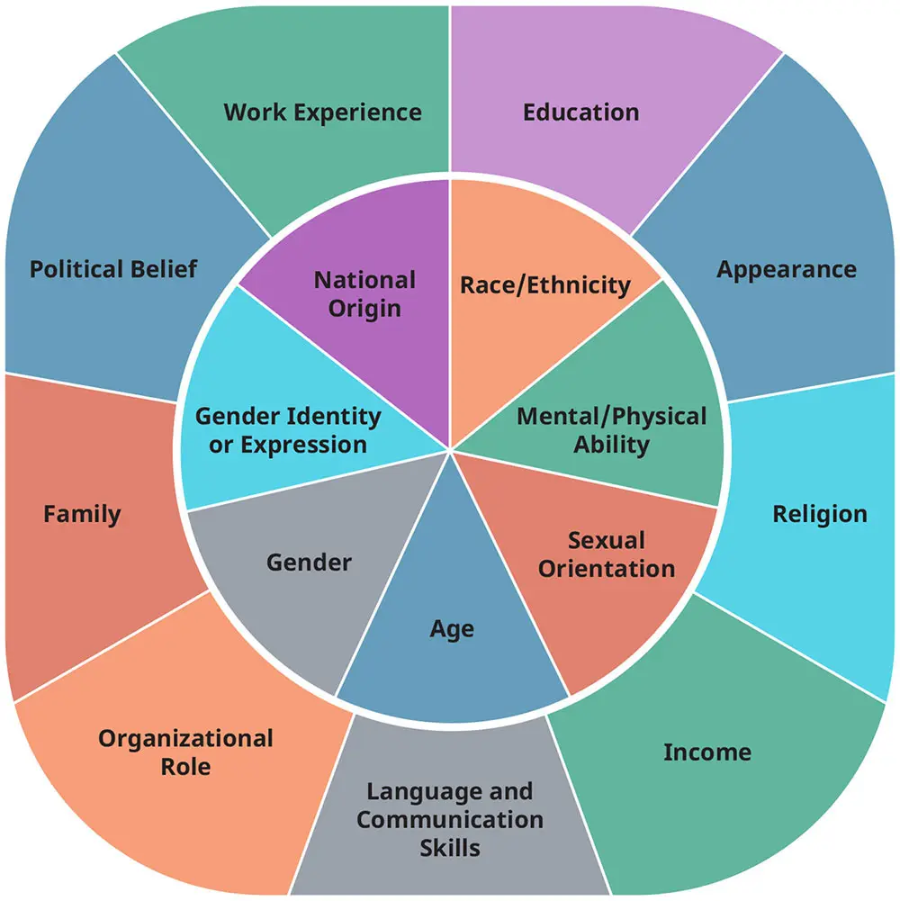
Intersectional Literary Reflections
In this exercise, teachers should support students to acquire a more profound and practical grasp of the intricate concept of intersectionality.
The activity achieves multiple objectives.
Notes:
First, students perform close readings of literary works and characters – generally for the former and specifically for the latter. Close readings provide concrete strategies for analyzing the intersectionality of personas, and students have more opportunities to deconstruct the language and literary devices in a text to generate different perceptions across personas.

Slide 15

Intersectional Literary Reflections
In a text such as Death of a Salesman, for instance, students can compare the male and female characters in the novel based on class and traditional gender roles.
Apart from comparing Willy Loman, who is struggling financially, with his prosperous neighbor Charley to illustrate themes of social stratification, students can examine the male characters and their pursuit of the American Dream.
Notes:
For instance, students can examine how the American Dream, the overriding theme in the play, affects Willy Loman and how he projects his working-class manhood. Willy’s masculinity, combined with his dogged pursuit of an elusive success, demonstrates how his socioeconomic situation and his gender roles define his identity. Students can also analyze the female characters, such as Linda Loman, and how they are portrayed in stereotypical household roles. These portrayals denote how the women are expected to conform to societal standards and accept the scarce opportunities they are given. The female characters’ roles can be examined from the intersectional perspective of feminism. Students can highlight, for instance, how women are shackled because of their gender and the patriarchal societal system of the time.

Slide 16
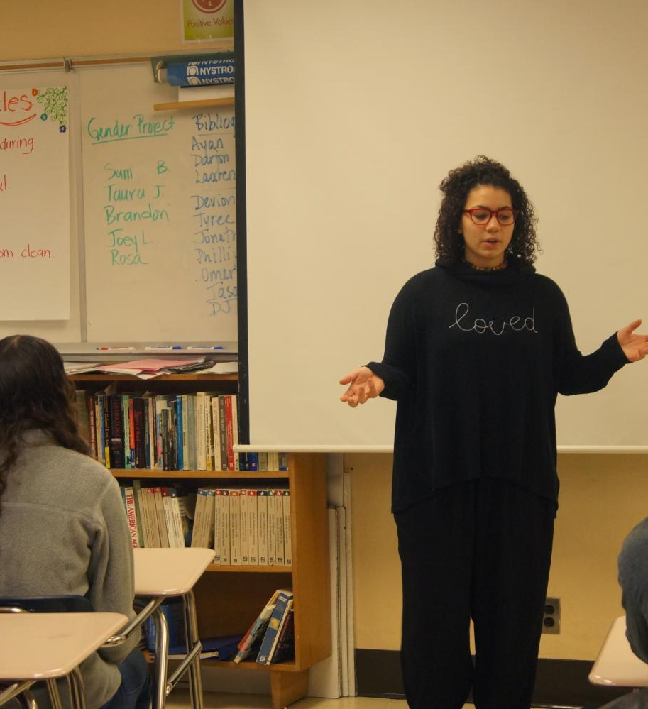
Intersectional Literary Reflections
Intersectional analysis allows students to develop a variegated understanding of literary works instead of focusing only on individual aspects such as race, class or gender.
Intersectional reading is applicable at any academic level and customized in various ways.
Notes:
In introductory classes, for instance, teachers can limit students to a pair of subjectivity factors or just one persona; nonetheless, juxtaposing personas can inspire a deeper interpretation of intersectionality. In advanced classes, teachers and students can explore subjectivity elements that are more explicitly addressed by the author; such factors could include domestic abuse, capitalism, gender roles, class, sexuality, marriage, family, urban geography, and racist tropes. Teachers can also select topics particular to certain courses, such as religion, consumerism, or vernacular speech. Students can also juxtapose personas from two distinct works, including an intersectional rendering of setting, gender, and class focused on Sula’s Sula Peace and Death of a Salesman’s Linda Loman.

Slide 17

Intersectional Literary Reflections
No matter the course level, teachers would find it useful to provide illustrations of notions that could be classified under a specific subjectivity factor.
For instance, for a factor like class, teachers can ask students to consider portrayals of possessions, work, financial security, income, education, attire, domestic life, liquid assets, or language.
Notes:
For context, students can concentrate on the household, workplace, location, transportation, public spaces, mobility, weather, architecture, or street life. Teachers can also annotate these themes on the board or include them in handout one. Intersectional reading allows students to feel more assured in their capacity to generate complex and specific interpretations of literary characters, devices, and themes across different texts. Since intersectional analyses are prominent in the humanities, they show how students and teachers can apply intersectional reading to different literary genres. Students will appreciate the practice and the liberal setting in which they are asked to investigate, more comprehensively, how a major feature of lived experience defines literary depiction.

